Slide 1

Chapter 24 - Quality Management
Chapter 24 Quality management

Slide 2
Software quality management
Concerned with ensuring that the required level of quality is achieved in a software product.
Three principal concerns:
At the organizational level, quality management is concerned with establishing a framework of organizational processes and standards that will lead to high-quality software.
At the project level, quality management involves the application of specific quality processes and checking that these planned processes have been followed.
At the project level, quality management is also concerned with establishing a quality plan for a project. The quality plan should set out the quality goals for the project and define what processes and standards are to be used.
Chapter 24 Quality management

Slide 3
Quality management activities
Quality management provides an independent check on the software development process.
The quality management process checks the project deliverables to ensure that they are consistent with organizational standards and goals
The quality team should be independent from the development team so that they can take an objective view of the software. This allows them to report on software quality without being influenced by software development issues.
Chapter 24 Quality management

Slide 4
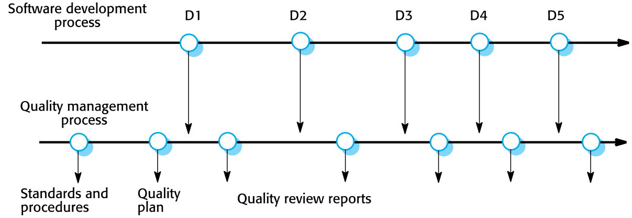
Quality management and software development
Chapter 24 Quality management

Slide 5
Quality plans
Quality plan structure
Product introduction;
Product plans;
Process descriptions;
Quality goals;
Risks and risk management.
Quality plans should be short, succinct documents
If they are too long, no-one will read them.
Chapter 24 Quality management

Slide 6
Software quality
Quality, simplistically, means that a product should meet its specification.
Quality attributes
Safety | Understandability | Portability
Security | Testability | Usability
Reliability | Adaptability | Reusability
Resilience | Modularity | Efficiency
Robustness | Complexity | Learnability
Chapter 24 Quality management

Slide 7
Software standards
Standards define the required attributes of a product or process. They play an important role in quality management.
Standards may be international, national, organizational or project standards.
Product standards define characteristics that all software components should exhibit e.g. a common programming style.
Process standards define how the software process should be enacted.
Chapter 24 Quality management

Slide 8
Product and process standards
Product standards | Process standards
Design review form | Design review conduct
Requirements document structure | Submission of new code for system building
Method header format | Version release process
Java programming style | Project plan approval process
Project plan format | Change control process
Change request form | Test recording process
Chapter 24 Quality management

Slide 9
ISO 9001 standards framework
An international set of standards that can be used as a basis for developing quality management systems.
ISO 9001, the most general of these standards, applies to organizations that design, develop and maintain products, including software.
The ISO 9001 standard is a framework for developing software standards.
It sets out general quality principles, describes quality processes in general and lays out the organizational standards and procedures that should be defined. These should be documented in an organizational quality manual.
Chapter 24 Quality management

Slide 10
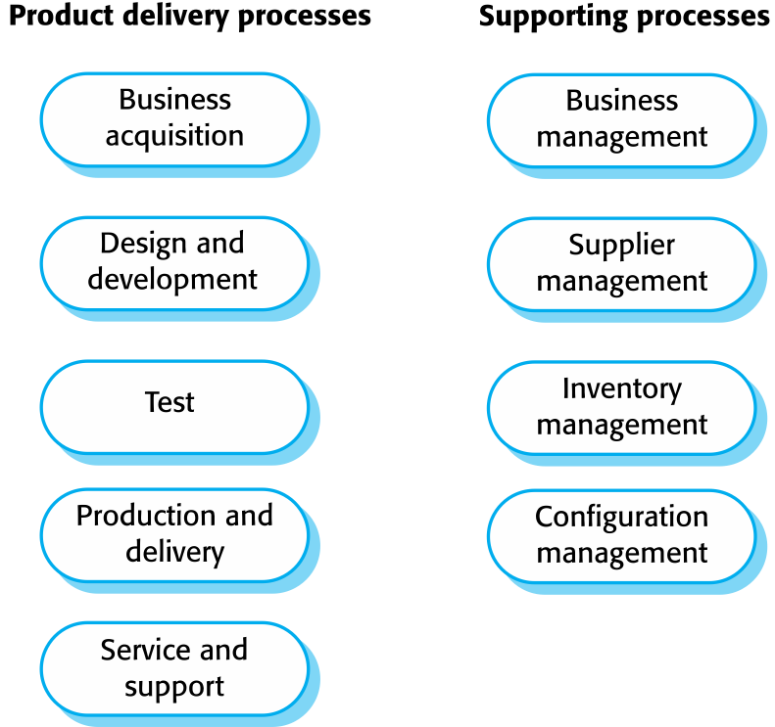
ISO 9001 core processes
Chapter 24 Quality management

Slide 11
Quality reviews
A group of people carefully examine part or all of a software system and its associated documentation.
Code, designs, specifications, test plans, standards, etc. can all be reviewed.
Software or documents may be 'signed off' at a review which signifies that progress to the next development stage has been approved by management.
Chapter 24 Quality management

Slide 12
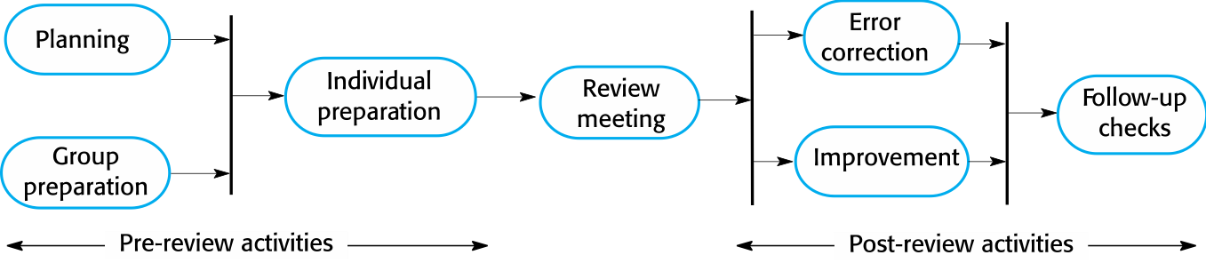
The software review process
Chapter 24 Quality management

Slide 13
Program inspections
These are peer reviews where engineers examine the source of a system with the aim of discovering anomalies and defects.
Inspections do not require execution of a system so may be used before implementation.
They may be applied to any representation of the system (requirements, design,configuration data, test data, etc.).
They have been shown to be an effective technique for discovering program errors.
Chapter 24 Quality management

Slide 14
Inspection checklists
Checklist of common errors should be used to drive the inspection.
Error checklists are programming language dependent and reflect the characteristic errors that are likely to arise in the language.
In general, the 'weaker' the type checking, the larger the checklist.
Examples: Initialisation, Constant naming, loop termination, array bounds, etc.
Chapter 24 Quality management

Slide 15
An inspection checklist (a)
Fault class | Inspection check
Data faults | Are all program variables initialized before their values are used? Have all constants been named? Should the upper bound of arrays be equal to the size of the array or Size -1? If character strings are used, is a delimiter explicitly assigned? Is there any possibility of buffer overflow?
Control faults | For each conditional statement, is the condition correct? Is each loop certain to terminate? Are compound statements correctly bracketed? In case statements, are all possible cases accounted for? If a break is required after each case in case statements, has it been included?
Input/output faults | Are all input variables used? Are all output variables assigned a value before they are output? Can unexpected inputs cause corruption?
Chapter 24 Quality management

Slide 16
An inspection checklist (b)
Fault class | Inspection check
Interface faults | Do all function and method calls have the correct number of parameters? Do formal and actual parameter types match? Are the parameters in the right order? If components access shared memory, do they have the same model of the shared memory structure?
Storage management faults | If a linked structure is modified, have all links been correctly reassigned? If dynamic storage is used, has space been allocated correctly? Is space explicitly deallocated after it is no longer required?
Exception management faults | Have all possible error conditions been taken into account?
Chapter 24 Quality management

Slide 17
Software measurement and metrics
Software measurement is concerned with deriving a numeric value for an attribute of a software product or process.
This allows for objective comparisons between techniques and processes.
Although some companies have introduced measurement programmes, most organisations still don’t make systematic use of software measurement.
There are few established standards in this area.
Chapter 24 Quality management

Slide 18
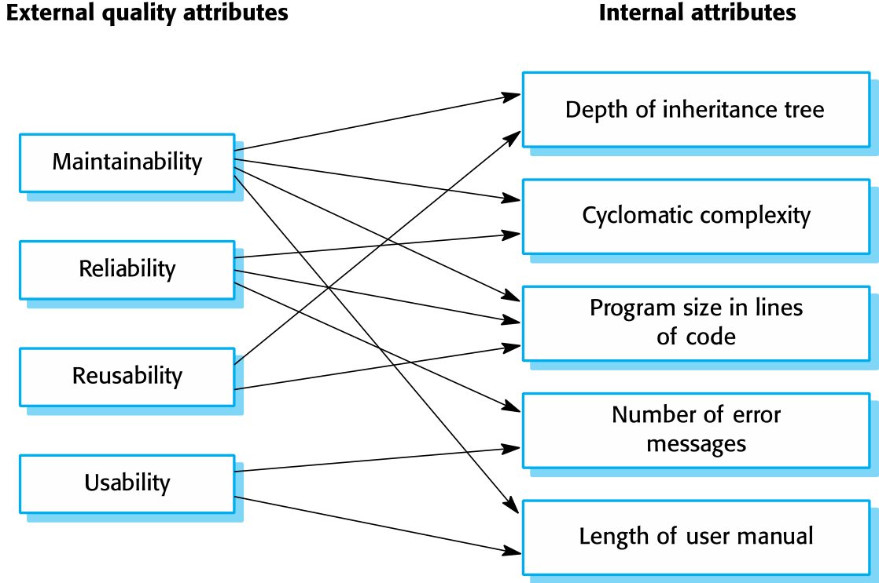
Relationships between internal and external software
Chapter 24 Quality management

Slide 19
Product metrics
A quality metric should be a predictor of product quality.
Classes of product metric
Dynamic metrics which are collected by measurements made of a program in execution;
Static metrics which are collected by measurements made of the system representations;
Dynamic metrics help assess efficiency and reliability
Static metrics help assess complexity, understandability and maintainability.
Chapter 24 Quality management

Slide 20
Dynamic and static metrics
Dynamic metrics are closely related to software quality attributes
It is relatively easy to measure the response time of a system (performance attribute) or the number of failures (reliability attribute).
Static metrics have an indirect relationship with quality attributes
You need to try and derive a relationship between these metrics and properties such as complexity, understandability and maintainability.
Chapter 24 Quality management

Slide 21
Static software product metrics
Software metric | Description
Fan-in/Fan-out | Fan-in is a measure of the number of functions or methods that call another function or method (say X). Fan-out is the number of functions that are called by function X. A high value for fan-in means that X is tightly coupled to the rest of the design and changes to X will have extensive knock-on effects. A high value for fan-out suggests that the overall complexity of X may be high because of the complexity of the control logic needed to coordinate the called components.
Length of code | This is a measure of the size of a program. Generally, the larger the size of the code of a component, the more complex and error-prone that component is likely to be. Length of code has been shown to be one of the most reliable metrics for predicting error-proneness in components.
Chapter 24 Quality management

Slide 22
Static software product metrics
Software metric | Description
Cyclomatic complexity | This is a measure of the control complexity of a program. This control complexity may be related to program understandability. I discuss cyclomatic complexity in Chapter 8.
Length of identifiers | This is a measure of the average length of identifiers (names for variables, classes, methods, etc.) in a program. The longer the identifiers, the more likely they are to be meaningful and hence the more understandable the program.
Depth of conditional nesting | This is a measure of the depth of nesting of if-statements in a program. Deeply nested if-statements are hard to understand and potentially error-prone.
Fog index | This is a measure of the average length of words and sentences in documents. The higher the value of a document’s Fog index, the more difficult the document is to understand.
Chapter 24 Quality management

Slide 23
Key points
Software quality management is concerned with ensuring that software has a low number of defects and that it reaches the required standards of maintainability, reliability, portability and so on.
Quality management procedures may be documented in an organizational quality manual, based on the generic model for a quality manual suggested in the ISO 9001 standard.
Reviews of the software process deliverables involve a team of people who check that quality standards are being followed.
Software measurement can be used to gather data about software and software processes.
Chapter 24 Quality management

